Slide 1
PREDICTING SHORT-TERM PRICE MOVEMENTS OF GOLD (XAUUSD) USING HISTORICAL OHLCV DATA

Slide 3


Slide 4

S/No | Author (s) | Model | Year | Key Finding
1 | Breiman | Random forest | 2001 | Handles non-linear data
2 | Huang et al | SVM | 2005 | High classification accuracy
3 | Patet et al | ML Models | 2015 | Feature engineering improves results
4 | Fischer & Krauss | LSTM | 2018 | Outperforms ML Models
5 | Huang et al. | ARIMA-LSTM | 2020 | Hybrid improves accuracy
6 | Lim et al | Transformer | 2021 | Captures long dependencies
7 | Li et al | GB | 2021 | Outperforms ARIMA
8 | Chen et al | ML +Indicators | 2021 | Feature engineering critical
9 | Zhang et al | Bi-LSTM | 2022 | Better temporal Learning
10 | Wang et al | CNN-LSTM | 2023 | Hybrid improves performance
11 | Azaria et al | LSTM | 2024 | Accurate Price forecast
12 | Alireza et al | ML Models | 2025 | Logistic highest accuracy
13 | Taneva et al | Comparative | 2025 | Prophet, Bi-LSTM, LSTM are best
14 | Mohammad et al | LSTM+TSCV | 2026 | Effective price prediction

Slide 9

RESULTS
The Random Forest model captured general patterns and performed slightly better than The LSTM model performed. It had an accuracy value of 0.5229 compared to Random Forest model with accuracy of 0.4977. Though both values are considered generally low. The use of feature engineered variables played a significant role in the accuracy of the model, but it was observed that using too many of such variables also seemed to slightly reduce accuracy as measured by the R-squared, due to over fitting.
The eventual Random Forest Model predicted data fit to the real historical data gave R-squared of 0.9939, MAE of 20.25 and RMSE of 22.24, which shows high accuracy for the fit of the model to actual gold historical data. The strategy performance varies between 0.81 and 1.00.

Slide 10
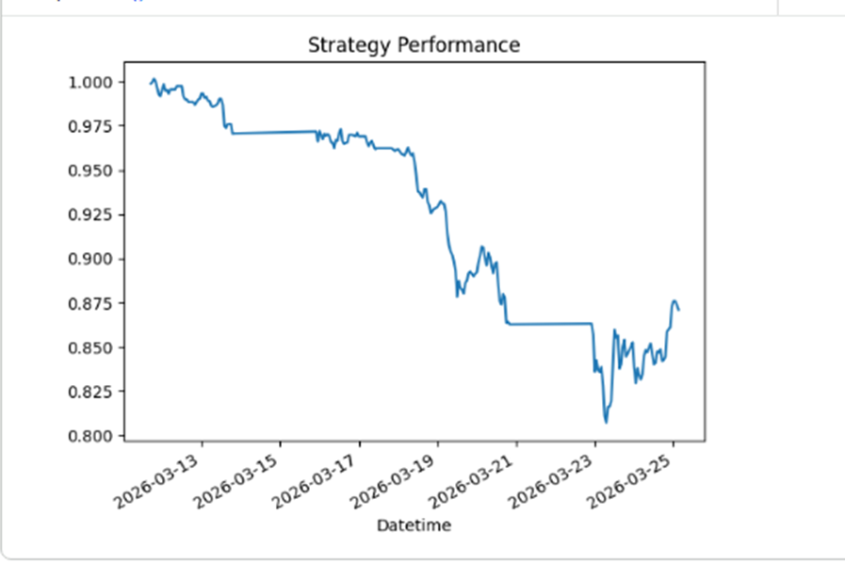

Slide 11
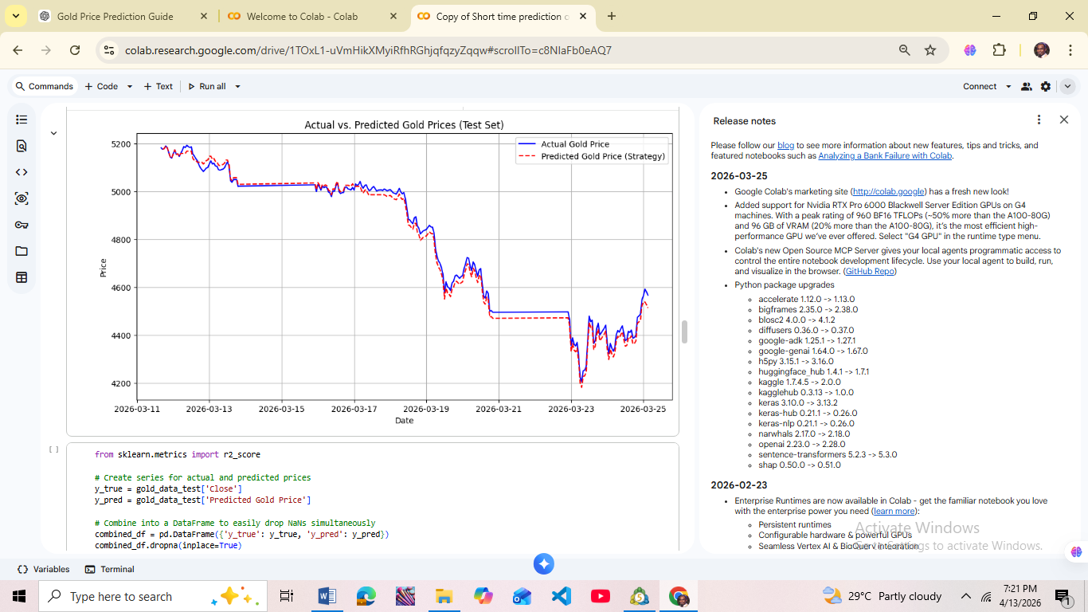

Slide 12
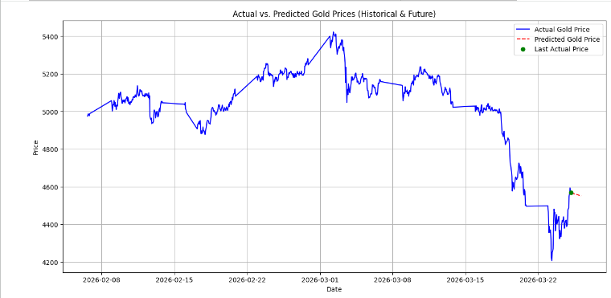

Slide 13
THANK YOU
OSOKA, EMMANUEL CHIBUIKE

